Slide 1
OpenSLAM ROS Gmapping
발표자 : 최병찬

Slide 2
목차
ROS
Gmapping 구성
ROS Gmapping
작동 방식
ROS Gmapping
적용 이론

Slide 3
ROS Gmapping 구성 및 작동 방식

Slide 4
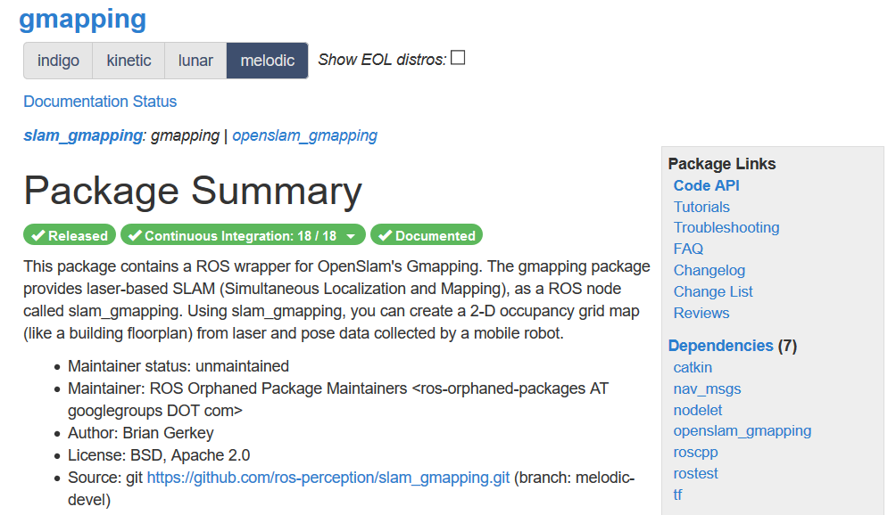
ROS Gmapping 구성
ROS Wrapper 및 gmapping Core Code 구성
구성
작동 순서
ROS gmapping Wrapper (gmapping)
main.cpp | gmapping SLAM Node 실행 메인 Node
slam_gmapping.cpp | gmapping SLAM Node 주요 기능 및 메소드 정의
nodelet.cpp | gmapping nodelet 구현
replay.cpp | ROS bag 파일 실행 코드
gmapping Core (openslam_gmapping)
gridslamprocessor.cpp | FastSLAM 연산기 객체
motionmodel.cpp | Motion Model 정의한 코드 (Gaussian noise model 사용) (Odometry, Velocity model 정의)
particlefilter.cpp | Particle Filter 구현 코드
scanmatcher.cpp | 지도 설계 및 연결 코드
sensor_base / sesnor_odometry / sensor_range | LiDAR 센서 연산 관련 코드
적용 이론
OpenSLAM.org : https://github.com/OpenSLAM-org/openslam_gmapping
ROS openslam_gmapping : https://github.com/ros-perception/openslam_gmapping
(Catkinized version of OpenSLAM gmapping)
ROS gmapping : https://github.com/ros-perception/slam_gmapping/tree/melodic-devel/gmapping/src

Slide 5
ROS Gmapping 작동 방식
ROS Wrapper 및 gmapping Original Core 작동 순서
구성
[ROS Wrapper]
[gmapping Original Core (openslam_gmapping)]
작동 순서
main.cpp
SlamGmapping()
gsp_ = new GridSlamProcessor()
적용 이론
slam_gmapping.cpp
SlamGmapping()::init() → GridSlamProcessor()
→ TransformBroadcaster()
slam_gmapping.h
gmapping/gridfastslam/gridslamproessor.h
startLiveSlam()
gmapping/sensor/sensor_base/sensor.h
slam_gmapping.cpp
publishLoop()
slam_gmapping.cpp
laserCallback()
gmapping/sensor/sensor_range/rangereading.h
gmapping/particlefilter/particlefilter.h
gmapping/scanmatcher/scanmatcher.h
slam_gmapping.cpp
publishTransform()
slam_gmapping.cpp
initMapper(scan)
(1st initial scan/map update)
gridslamprocessor.cpp
processScan(RangeReading);
→ RangeReading.getPose()
→ onOdometryUpdate()
→ onScanmatchUpdate()
→ updateTreeWeights
slam_gmapping.cpp
getOdomPose()
slam_gmapping.cpp
addScan(scan, gmapping_pose)
odom_frame_
gridslamprocessor.h
getParticles()
slam_gmapping.cpp
updateMap()
map_frame_
slam_gmapping.cpp
ScanMatcher
Map Construction & Resize
gridslamprocessor.cpp
PaticleVector& [getBestParticleIndex()].pose
Map Construction
Localization

Slide 6
ROS Gmapping 적용 이론
Filters for SLAM
구성
작동 순서
For Linear Model / Environment :
Kalman Filter
A type of Bayes Filter for linear Gaussian distribution and models
Localize the robot’s pose x_{t} by acquiring the Gaussian probability distribution of its location
Since all we need to know is Gaussian distribution of the robot’s pose,
we can represent the location of the robot by updating mean μ_{t} and variance ∑_{t}
Prediction Step : Compute the robot’s possible pose based on odometry information
Correction Step : Adjust the distribution of the robot’s possible pose with sensor data
For Model with Little Non-Linearity :
EKF (Extended Kalman Filter)
Linearize Kalman Filter using 1st order Taylor series for non-linear situations
For Completely Non-Linear Model / Environment :
Particle Filter (Low Density)
Sample-based filtering representation / Non-parametric method
Very flexible in distribution representation
Suited for low dimensional spaces (∵ Sampling requirement)
적용 이론

Slide 7
ROS Gmapping 적용 이론
Filters for SLAM
구성
작동 순서
For Completely Non-Linear Model / Environment :
Rao-Blackwellized Particle Filter (High Density) / (Used in ROS gmapping)
Sample-based filtering representation / Non-parametric method
Very flexible in distribution representation
Improvements from conventional particle filter for high dimensional environment
Split path trajectory from mapping info under following assumptions
Assumption 1 : “If we know the pose of the robot, we will know mapping info”
Assumption 2 : “Each particle provides its own mapping result”
Factorization of SLAM posterior : Divide path trajectory and mapping, and compute them separately.
Compute path trajectory of the robot by using Monte Carlo Localization
Simplify the massive matrix used for mapping as the series of 2D EKFs
In order to reduce the computation overhead, Binary Search Tree is implemented in order to
pick the particles with the best estimation probability.
Rao-Blackwellized Particle Filter will first estimate only the trajectory of the robot,
then build the map incrementally by repetitively performing smaller 2D EKFs.
적용 이론

Slide 8

ROS Gmapping 적용 이론
Rao-Blackwellized Particle Filter
구성
작동 순서
Reference : Giorgio Grisetti, Cyrill Stachniss, Wolfram Burgard “Improved Techniques for Grid Mapping with Rao-Blackwellized Particle Filters”,
IEEE Transactions on Robotics, Volume 23, pages 34-46, 2007
http://www2.informatik.uni-freiburg.de/~stachnis/pdf/grisetti07tro.pdf
적용 이론
Rao-Blackwellized Particle Filter
Basic Properties
Sample-based filtering representation / Non-parametric method
Split path trajectory from mapping info under following assumptions
Assumption 1 : “If we know the pose of the robot, we will know mapping info”
Assumption 2 : “Each particle provides its own mapping result”
Factorization of SLAM posterior : Divide path trajectory and mapping, and compute them separately.
Rao-Blackwellized Particle Filter will first estimate only the trajectory of the robot,
then build the map incrementally by repetitively performing smaller 2D EKFs.

Slide 9
ROS Gmapping 적용 이론
Rao-Blackwellized Particle Filter
구성
작동 순서
How to acquire samples / particles? – SIR (Sample Importance Resampling)
Sampling → Importance Weighting → Resampling → Map Estimation
Sampling : Acquire next generation of samples / particles by sampling from “proposal distribution”
(※ Proposal distribution : How the particles of vehicle will be represented based on sensor data and odometry data?)
(※ Probabilistic odometry motion model is used as the proposal distribution)
Importance Weighting : Assign weight to each particle according to importance sampling principle
(※ 각 파티클의 유효성에 따라 Weight값을 부여하여, 최상의 연산 결과를 선정함)
Resampling : Draw particles with replacements proportional to their weight
(※ Draw/Sample with replacement : 복원 추출 / 모집단에서 원하는 데이터를 뽑은 다음 다시 원상 복귀 시킴)
(※ Particle Depletion : 각 파티클 중 최상의 파티클만 선정을 하다보면 사용 가능한 파티클이 점점 줄어들게됨)
(※ Particle Depletion에 의해 미래에 유효할 수 있는 데이터가 사라질 가능성이 높으며, 신뢰도가 급감함)
Map Estimation : For each particle, compute the corresponding map estimate based on
the trajectory of samples / particles and the history of sensor data
적용 이론

Slide 10
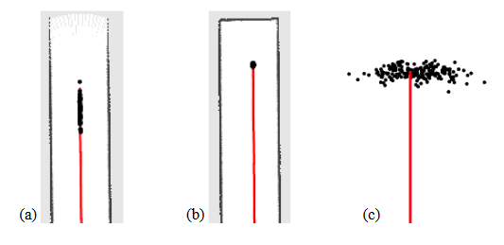
ROS Gmapping 적용 이론
Rao-Blackwellized Particle Filter
구성
작동 순서
Main issues regarding the performance of Rao-Blackwellized Particle Filter
How to define more effective / appropriate proposal distribution?
Environment with many distinct features and obstacles
Odometry-based proposal distribution < 2D LiDAR Sensor-based proposal distribution
Reason : 2D LiDAR sensor data shows more dramatic changes to distinct environment features than odometry sensors.
Environment with few distinct features (ex : Long empty corridor)
Odometry-based proposal distribution > 2D LiDAR Sensor-based proposal distribution
Reason : Most of 2D LiDAR sensor data shows max range. As a result, odometry produces more meaningful data.
Solution : Motion Model + Latest 2D LiDAR sensor data + Scan-matching
(※ Scan-matching : Focus on meaningful area of distribution, thus direct sampling on important regions)
적용 이론

Slide 11

ROS Gmapping 적용 이론
Rao-Blackwellized Particle Filter
구성
작동 순서
Main issues regarding the performance of Rao-Blackwellized Particle Filter
How to conduct resampling without losing too many of potentially good particles?
Solution : Adaptive Resampling
Conduct resampling only when certain criterions for resampling are satisfied
Conduct resampling only when needed
적용 이론
N_{eff} (Effective Sample Size)
= Measure of the dispersion of the importance weights
= Evaluate how well the particle set approximates the target posterior
→ Conduct resampling only when N_{eff} drops below N/2, where N is the number of particles
Weight값이 낮은 값이 많으면 | Weight값이 높은 값이 많으면
N_{eff} 높아짐 | N_{eff} 낮아짐
의미 있는 데이터가 적음 | 의미 있는 데이터가 많음
Target Distribution과 매우 다른 분포를 띄움 | Target Distribution과 유사한 분포를 띄움
Resampling을 통해 가져갈 Particle의 거의 없음 | Resampling을 통해 가져갈 Particle의 매우 많음
Resampling 통한 의미있는 Particle 선정 불가 | Resampling 통한 의미있는 Particle 선정 가능

Slide 12
Thank You
한양대학교 ICSL
최병찬

